Slide 1


Data ProSolveRS

Slide 2






Data
ProSolveRS
Pritish Saha
Rounak Nath
Srinjoy Ganguly
Notes:
Good Morning Judges....
I am Srinjoy Ganguly
......Pritish
...Rounak
and we are team
DATA ProSolveRS.

Slide 3







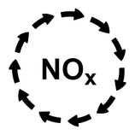
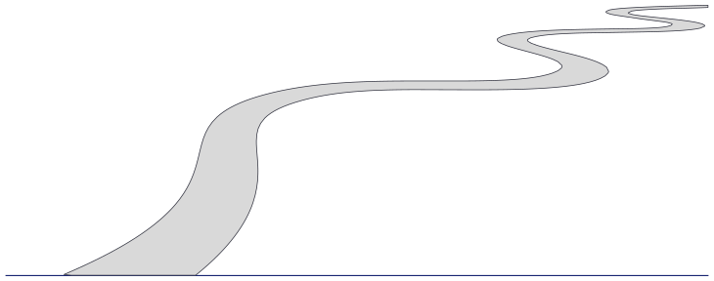







AIR POLLUTION AND RH
Ozone (O3)
Secondary Aerosol Formation: Ozone can react with volatile organic compounds (VOCs) and other pollutants in the atmosphere to form secondary organic aerosols (SOAs), which, as mentioned earlier, can be hygroscopic and contribute to an increase in relative humidity.
Nitrogen Oxides (NOx)
Formation of Nitric Acid Aerosols: NOx emissions can react with atmospheric moisture to form nitric acid (HNO3) aerosols, which are also hygroscopic and can contribute to an increase in relative humidity by absorbing water vapor.
Carbon Monoxide (CO) and Carbon Dioxide (CO2)
While carbon monoxide and carbon dioxide themselves do not directly affect relative humidity, their presence in the atmosphere can influence atmospheric processes that indirectly affect RH, such as temperature regulation and cloud formation.
Volatile Organic Compounds (VOCs)
Secondary Organic Aerosol Formation: VOCs can undergo photochemical reactions in the atmosphere to form secondary organic aerosols (SOAs), which can be hygroscopic and contribute to an increase in relative humidity through water vapor absorption.
Air Pollution and RH
EDA
Pre-Processing
Model prediction
Notes:
Well...we know from the problem statement, that these pollutants used as features influence the Relative humidity levels. nitrous oxides by forming nitric acid aerosols, ozone reacting with volatile organic compounds forming secondary organic aerosols and other pollutants in other ways.

Slide 4
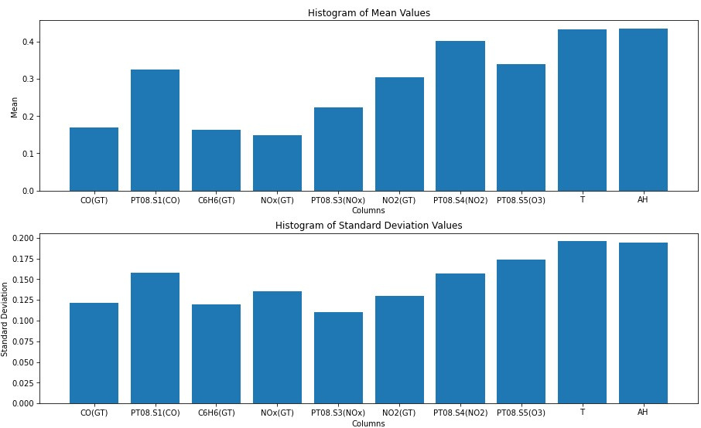
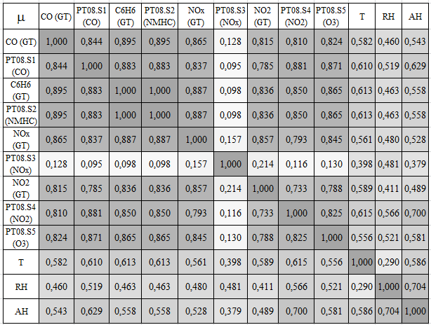
EXPLORATORY DATA ANALYSIS
Mean of each column
Insights from EDA: Summary statistics, distribution, standard deviation, and correlations illuminate key aspects of the dataset
Correlation heatmap
Standard Deviation of Each column
Air Pollution and RH
EDA
Pre-Processing
Model prediction
Notes:
We initially studied the theoretical influence of the pollutants on relative humidity. We studied various research papers on the correlation between the pollutant's effects on RH and tried to identify parameters that are repetitive in our analysis and could be removed.
By looking at the mean and std deviation values we figured out the requirement of eliminating the outliers in the dataset.
With these insights to be implemented, we moved on to data pre-processing

Slide 5
DATA PREPROCESSING
Removal of columns
Label Encoding
The RH categories ('Dry', 'Ideal', 'Slightly Elevated', 'Elevated', 'High') were encoded into numerical values for model training.
The column ‘NMHC(GT)’ has been removed as the column has 7086 missing values and the removal of the column is beneficial for better fitting the model.
The column ‘PT08.S2(NMHC)’ has been removed as the feature has a correlation value of ‘1.00’ with the column ‘C6H6(GT)’, so we need only one column to fit the model. The above mentioned correlation value is acquired from EDA.
Removal of rows
289 rows had missing values for AH. After getting a closer look we can also notice that in those rows other 4 columns also have missing values, so these rows aren’t suitable for KNN imputation. On the other hand, due to the number of total rows(8000) being much higher than 289 and due to the fact these rows have a lot of missing values, we safely removed these rows for better fitting of the curves.
The columns 'Date' and 'Time' were dropped as they represent timestamp information (DD/MM/YYYY and HH.MM.SS) that may not directly contribute to predicting relative humidity levels. Instead, time-related patterns and trends can be captured using additional features derived from these timestamps during feature engineering.
The 'ID' column was dropped as it serves as a unique identifier for each data point and does not provide any predictive value for relative humidity classification. Including such identifiers as features may introduce noise and unnecessary complexity to the model.
Imputation
As the columns ‘CO(GT)’, ‘NOx(GT)’, and ‘NO2(GT)’ have almost 1600 missing values, and the total number of rows is 8000 KNN imputation is used to impute the missing values.
Air Pollution and RH
EDA
Pre-Processing
Model prediction

Slide 6
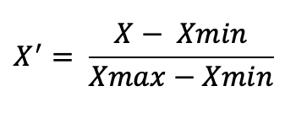
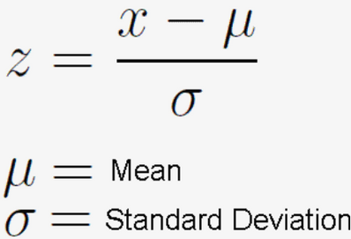
DATA PREPROCESSING
Max Normalization
Performs a linear transformation on the original data. This technique gets all the scaled data in the range (0, 1).
(Train Accuracy = 98.65%)
(Test Accuracy = 97.86%)
Dropping unnecessary columns
Z-Score Normalization
Normalizing the data using Z-score, Max(best), Min-max normalization
Z-score normalization transforms the data into a mean of 0 and a standard deviation 1.
(Train Accuracy = 98.09%)
(Test Accuracy = 96.30%)
The dataset was split into training and testing sets. The training set contains 75% of the data, while the testing set contains the remaining 25%.
Min–Max Normalization
Performs a linear transformation on the original data. This technique gets all the scaled data in the range (0, 1).
(Train Accuracy = 97.61%)
(Test Accuracy = 96.11%)
Air Pollution and RH
EDA
Pre-Processing
Model prediction

Slide 7
MODEL PREDICTION
SVM
Description
Insights
Decision trees, a versatile machine learning model, were employed to predict the RH. By partitioning the feature space based on intrinsic parameters such as total concentration of CO, NOx, NO2 etc, decision trees offer an intuitive approach to making predictions, allowing for easy interpretation of the underlying decision-making process.
The high accuracy scores achieved on both the train and test datasets indicate that the SVM model effectively captures the underlying patterns in the data and generalizes well to unseen data. This suggests that the decision boundaries learned by the SVM algorithm are robust and reliable for predicting RH categories.
The high accuracy on the test dataset (93.97%) suggests that the model performs well on new, unseen data, indicating its potential for real-world applications.
The slight drop in accuracy from the train dataset (94.68%) to the test dataset (93.97%) indicates a small degree of overfitting, but the model still demonstrates strong performance overall.
Accuracy
Train
Test
94.68%
93.97%
Air Pollution and RH
EDA
Pre-Processing
Model prediction

Slide 8
MODEL PREDICTION
MLP
Description
Insights
In summary, this code defines a simple neural network architecture, compiles it with appropriate loss and optimizer settings, and trains it using the specified training data. The goal is likely to perform a classification task based on the given features (X_train) and labels (y_train). Certainly! Multilayer Perceptrons (MLPs), a type of feedforward neural network, consist of interconnected layers of neurons. They learn complex relationships from input data and are widely used in meteorology to predict parameters like relative humidity.
Model Architecture:
The code initializes a sequential neural network model using Keras (a high-level neural networks API).
The model is named “my_model.”
It consists of two layers:
Dense Layer 1:
Units: 50 (number of neurons in this layer)
Activation function: ReLU (Rectified Linear Unit)
Dense Layer 2:
Units: 5 (number of neurons in this layer)
Activation function: Linear (no activation function applied)
Model Compilation:
The model.compile() function configures the model for training.
Loss function: Sparse Categorical Crossentropy (used for multi-class classification tasks with integer labels)
Optimizer: Adam (an efficient gradient-based optimization algorithm)
Learning rate for the optimizer: 0.01
Training the Model:
The model.fit() function trains the model on the provided training data (X_train and y_train).
The training process runs for 500 epochs (iterations).
Accuracy
Train
Test
98.65%
97.86%
Air Pollution and RH
EDA
Pre-Processing
Model prediction

Slide 9

Thank You!
Data ProSolveRS

